Slide 1
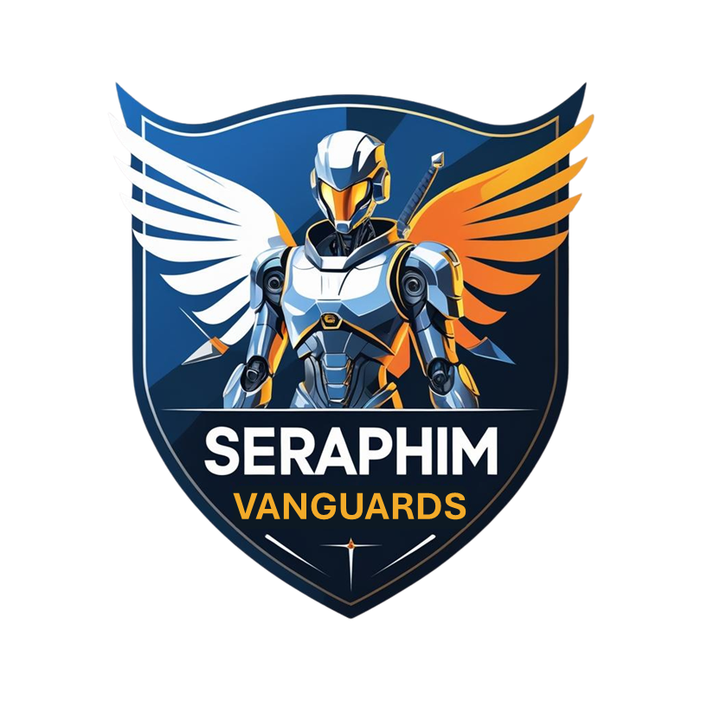

Security Integrity Accuracy
A scaleteam6 portfolio company.

Slide 2
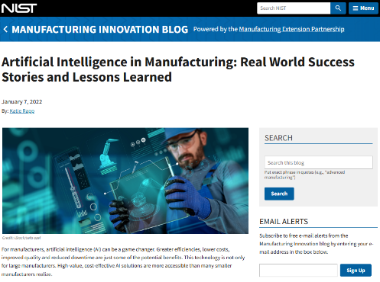
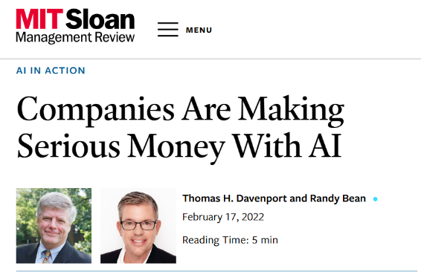

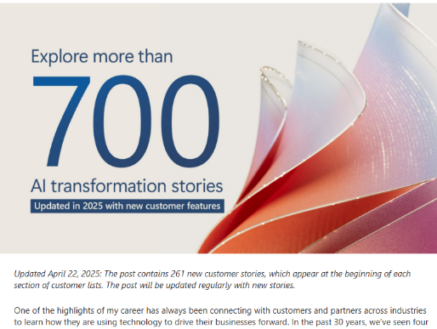
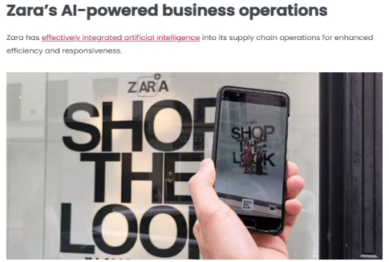
AI Offers Exponential Benefits …
AI has saved companies over $1 Trillion, projected to $6 Trillion by 2030⁽¹⁾
Can produce efficiencies of up to 30% ⁽²⁾ and increase revenue up to 10% ⁽³⁾

Slide 3

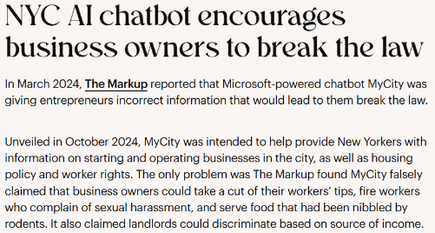
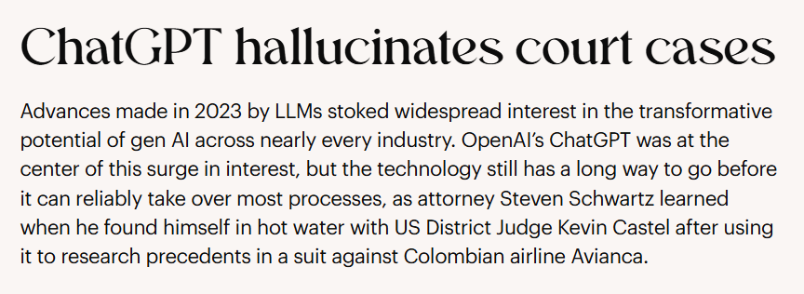
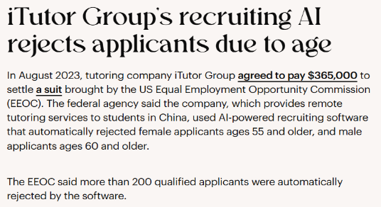
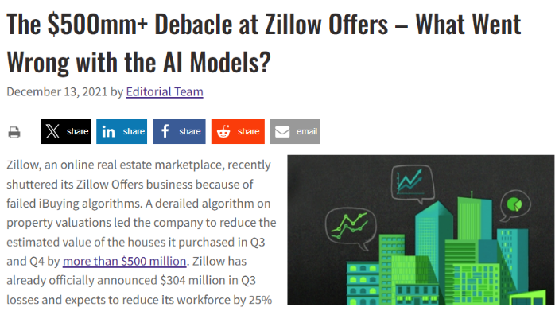
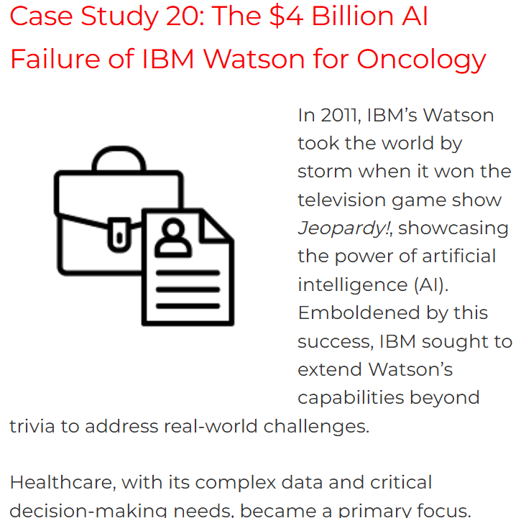
But with Exponential Risks…
Up to 60% of all AI responses are flawed
Up to 70% of all AI projects are cancelled
$67.4 Billion lost in 2024 alone due to AI errors
In high-stakes sectors, one bad response can cost millions or even cause lives to be lost.

Slide 4








The Opportunity
70%
Banking, Finance & Insurance
Healthcare & Pharmaceuticals
Of all US organizations have significant regulatory requirements
Energy & Utilities
Transportation & Logistics
All publicly traded companies
All levels of government
All organizations in many key industries
Telecom& Tech
Manufacturing & Food Services
In the US alone, the serviceable market for the tools to support these industries is estimated to be $187B today, growing to $320B by 2028.
Education
Government

Slide 5
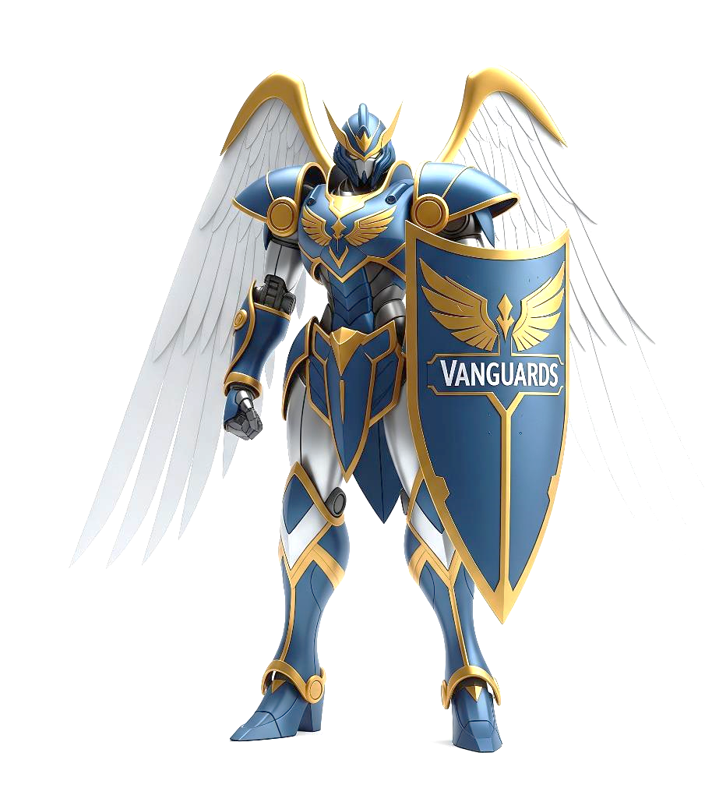
You Need AI You Can Trust
What If there was a platform that ensures …
Security
Integrity
Accuracy
Vanguards puts you in control.

Slide 6
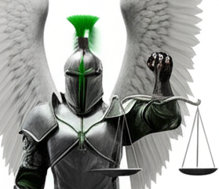
Vanguards is...
Not another model.
Not another chatbot.
Not just an AI wrapper.
It is a secure platform that governs the agents, validates the output, ensures compliance, and keeps you in charge.
True Enterprise-grade Standards
Built-in data validation and accuracy controls
Zero Hallucination Responses
Full audit hooks and chain-of-custody trails
Works with your existing systems to make AI trustworthy
Control over your AI consumption and spend
Goes Beyond Industry Best Practices
Flexibility - Cloud, edge, and on-prem

Slide 7

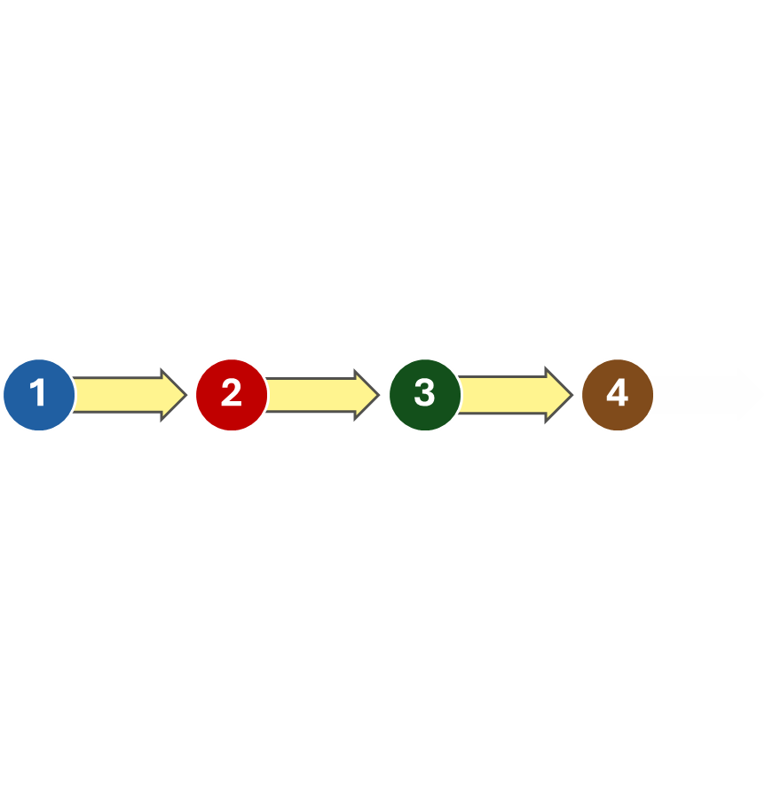
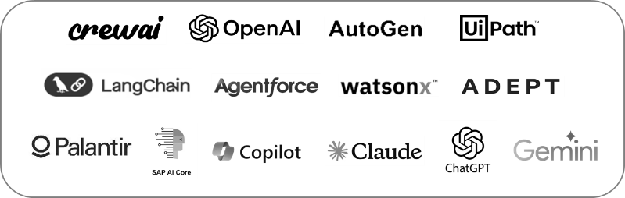
Vanguards Work With Your AI Tools
Vanguards Platform
Inspect & Optimize Agents in Host Platforms
Monitors & Logs Agent’s Data Access & Work
Inspects Agent Output and Validates Accuracy
Produces final clean output with logs for confidence.
Security
Integrity
Accuracy
Powered by Standards
Built on Proven Industry & Government Standards for Operations, Compliance & Audit
Works with and Enhances Industry Platforms, Orchestration Tools and LLMs.
US SOX
EU GDPR
US HIPPA
CNSSI-1015 (EAM)
CNSSI-1017 (ICAM)
CNSSI-1254 (Risk Framework)
DHHS IVV Framework
NASA IVV Guidelines
NIST 800-37.R2 (Risk Framework)
NIST 1500-18-R2 (Dara Framework)
OMB Data Quality Playbook
US Bureau of Justice Statistics Data Quality
DoD Data Strategy 2020
US Dept of Health PDDQ Framework
NERC-CIP v5
FCSM-20-04 rev 09-2020 (Data Quality)
US Federal Zero Trust Data Security Guide
GSA Section 515 - Data Quality Guidelines
GAO Data Governance v Dec 2020
US OMB 67-FR-8452 (Data Quality)
California DGS 4940.3 ( IV&V Framework(
State of Florida IV&V Methodology
European Commission ESS – Quality Assurance
Uk Gov Data Quality Framework – 3 Dec 2020
IMF-DQAF-2003 (Data Quality)
World Bank Data Standards
IEEE-STD-610
IEEE-STD-1012
IVVPBOK
Six Sigma

Slide 8
Vanguards Value to the Business
Vanguards puts you in control of your business.
Works With Your Existing Tools & Data
Applies Proven Processes & Stand
Reduces AI Errors
Gives You Confidence in Your AI Results with Documentation to Support it
Helps You Comply with Regulatory & Audit Standards

Slide 9

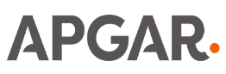

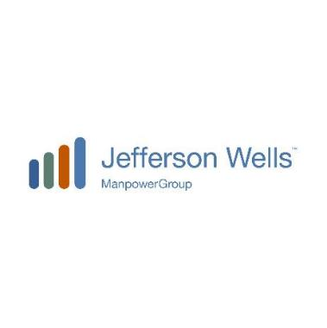


Go To Market Approach
Launch Focus on US Regulated Industries
Proven Markets
Industry Experience
Industry Contacts
Multi-Revenue Streams
Licensing & SaaS
Integration Partners
App & Tool Marketplace
GTM empowered by Key Partners
Tech GTM Experts from Salesforce & Apple
Risk & Audit Firms Actively Working in Target Industries
Innovation Labs

Slide 10


Product Roadmap
Vanguards
RELEASES
Integrates with existing commercial platforms
Provides Enhanced Security
Provides Data Integrity Validation
Provides Output Accurcy Verification
PHASE 1
POC
Security
Integrity
Accuracy
MVP
Seraphim Platform
Adds Controlled Auditable Environment
Provides Enhanced Continuity & Resiliency
Adds a Community Marketplace
PHASE 2
Orchestration
Marketplace
Resiliency
R2
Integrates with Others or Is Self Contained
Full AI Stack Platform
Extendable Multimodal Workflows & UI’s
PHASE 3
AI Studio
Multiplatform
Full Stack
R3

Slide 11




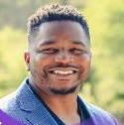

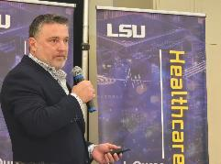





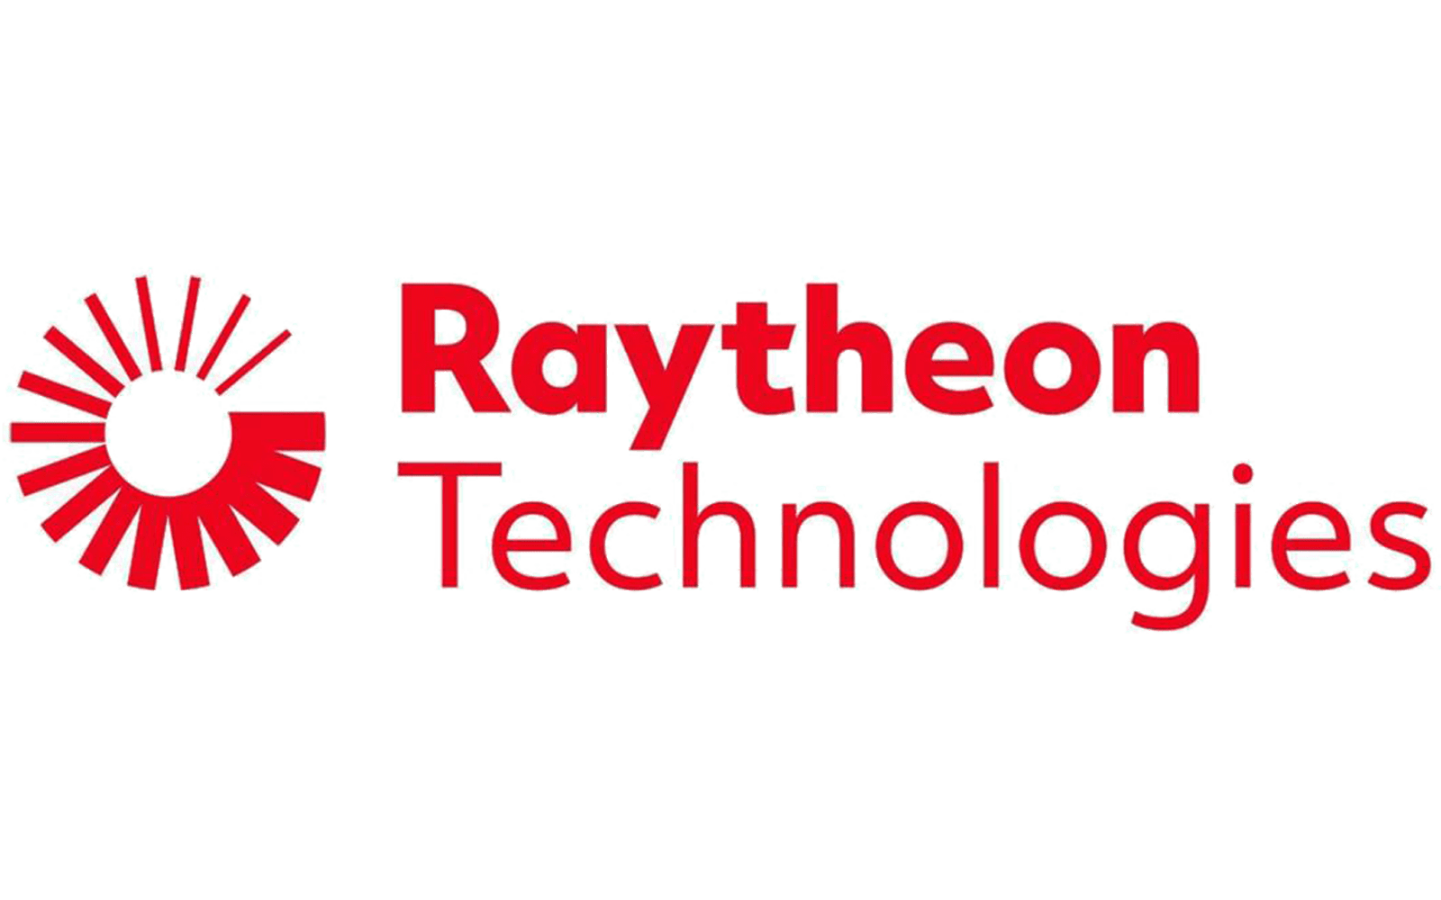







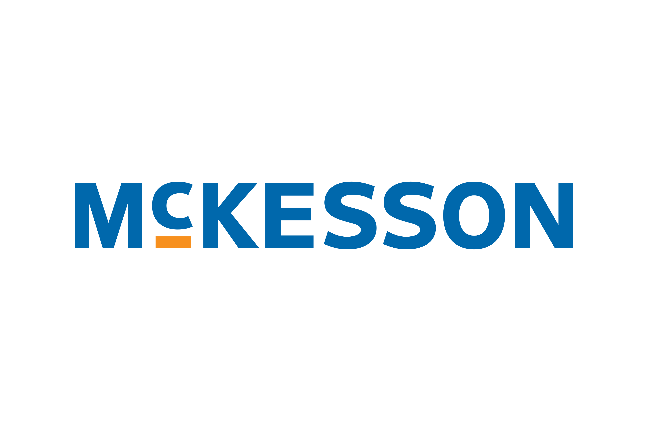

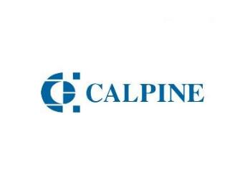


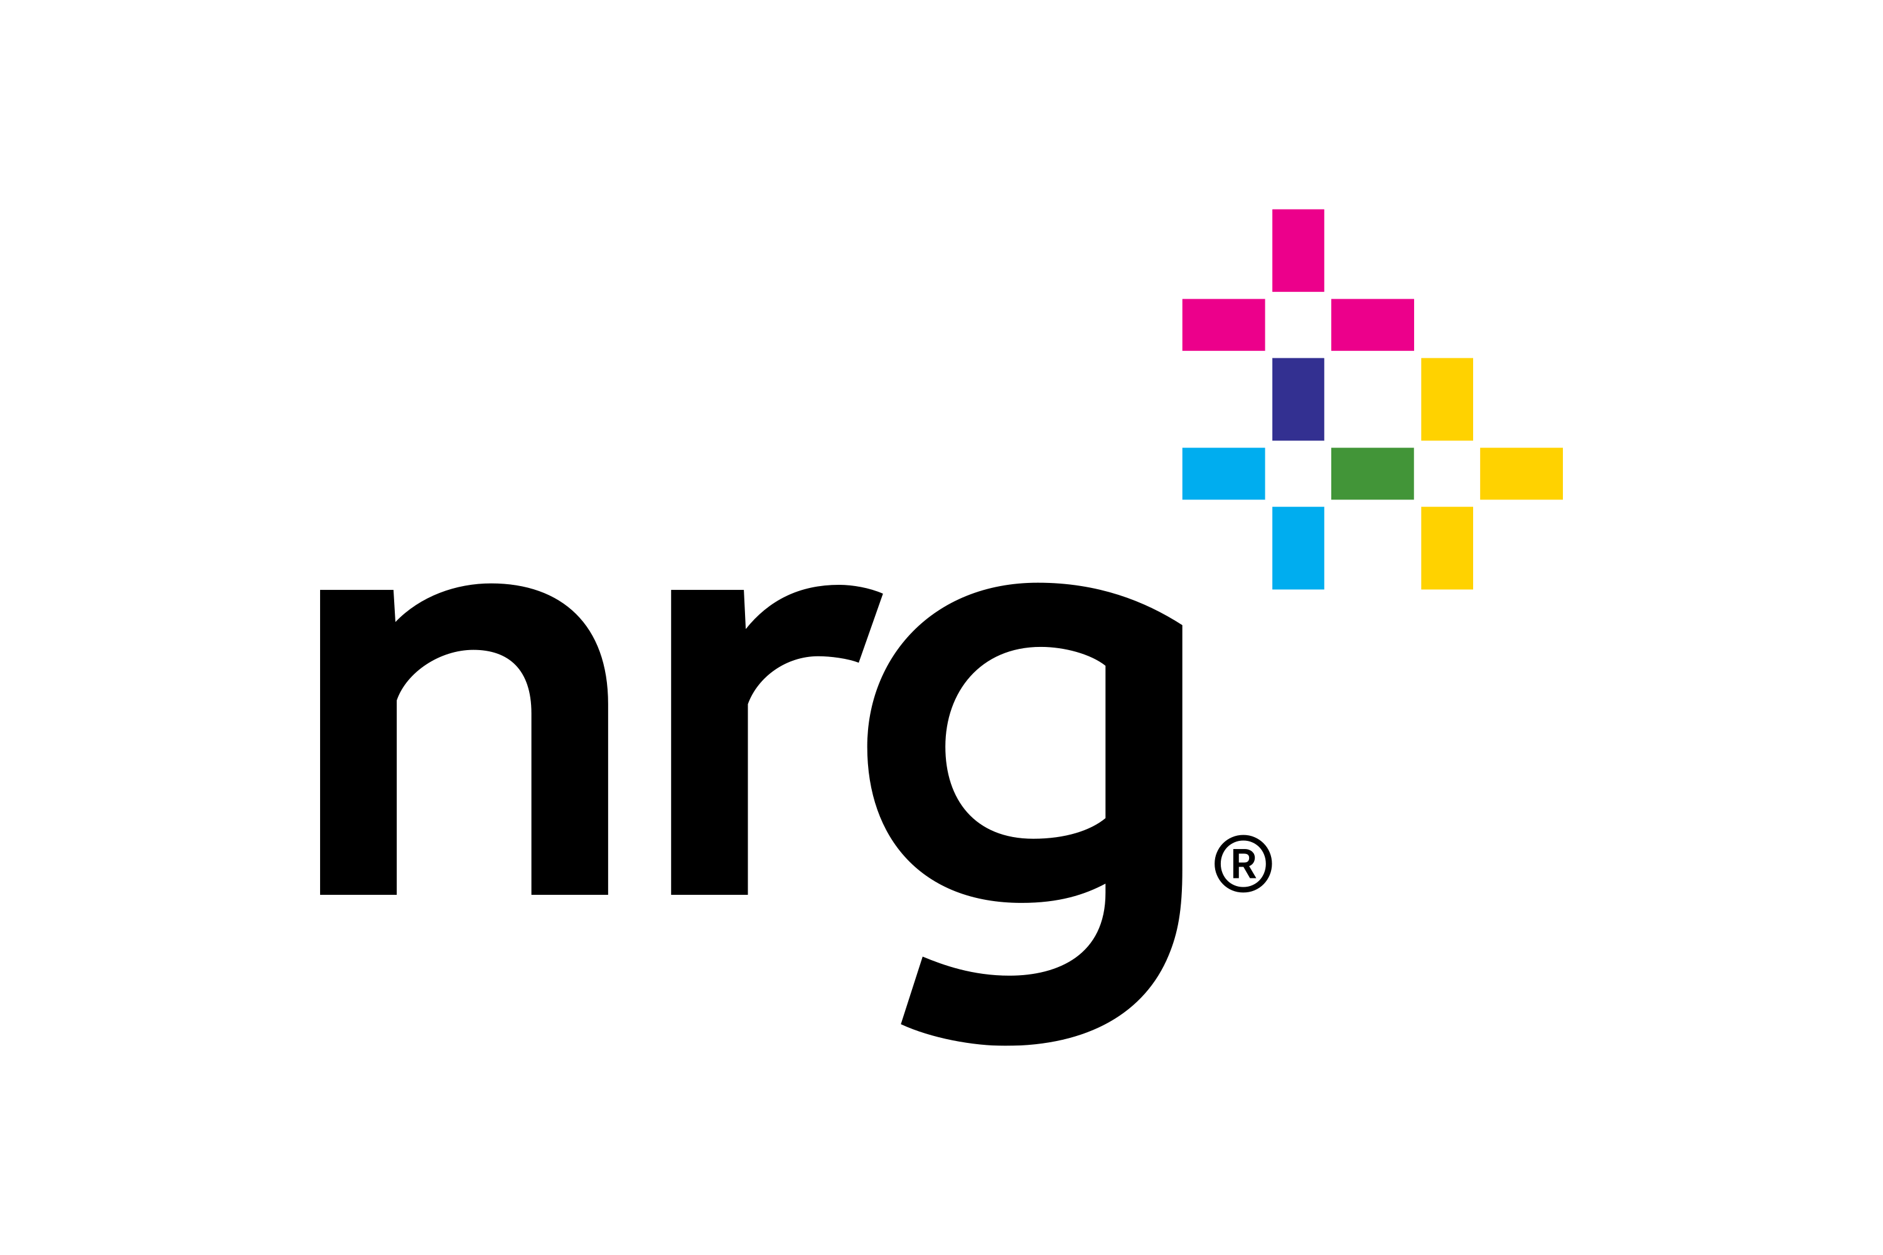



The Right Team …
140+ years combined experience in technology, business, and sales
Experience across more 20+ startups, including 1 IPO, Multiple successful exits
Experience creating and launching commercial applications
Alumni from Top Firms & Schools : IBM, Salesforce, Sungard, Palo Alto, Raytheon, IESE, EDHEC
Leadership Team
Key Advisors
Ron Elkins
CEO
Anthony Blow
CTO
Julian Tandler CRO
Mary LoMonaco COO
Kevin Love
Chief Architect
Corey Kaye
CISO
Darren Haas Siri, Apple, GE
Paola Saibene DBU & GWU
Telisa Toliver Atmos Energy
Andrew Schwarz LSU
Chris Draper Founder MorriganAI

Slide 12

We Need Your Help
This is your opportunity to build the platform the world will run on.
Join the Vanguards team today as an …
Advisor
Investor
Contributor
Collaborator
Promoter
Beta User
Customer
Notes:
Raising pre-launch capital to accelerate MVP, finalize launch partnerships, and scale GTM.
Target Investor Fit:
Strategic capital ready to own the platform AI will run on.

Slide 13

Thank You!

